Slide 1
ASP.NET MVC UI Recipes
Build Better Interfaces With Less Code
Dustin Ewers
Twitter: @DustinJEwers
Website: www.dustinewers.com
LinkedIn: www.linkedin.com/in/dustinewers
Demo Code:
github.com/DustinEwers/dot-net-mvc-ui-demos

Slide 2
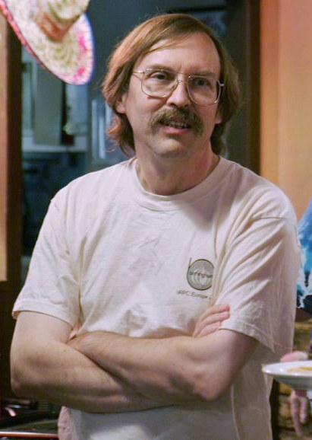
“We will encourage you to develop the three great virtues of a programmer:
laziness, impatience, and hubris.”
Larry Wall (He invented Perl)
By Randal Schwartz from Portland, OR, USA (Flickr) [CC BY-SA 2.0 ],
via Wikimedia Commons
Notes:
Source: http://en.wikipedia.org/wiki/File:Larry_Wall_YAPC_2007.jpg

Slide 3

By Isderion (Own work) [CC BY-SA 3.0 de (http://creativecommons.org/licenses/by-sa/3.0/de/deed.en)], via Wikimedia Commons
Notes:
http://commons.wikimedia.org/wiki/File:Bear_in_Hammock.JPG

Slide 4
My Story
Notes:
Story: Webforms Controls -> Rails -> ASP.MVC -> Struggle -> Enlightenment
I started off on webforms... began to think there was a better way
- thought of a way to directly translate data into UI elements
Then I met Rails, but it's a fast moving target and I'm a Microsoft guy
Then I found that Microsoft copied it with ASP.NET MVC
When I started ASP.NET MVC, I had a lot of trouble, because bad documentation
After piecing together blog entries and SO questions, I found my way

Slide 5
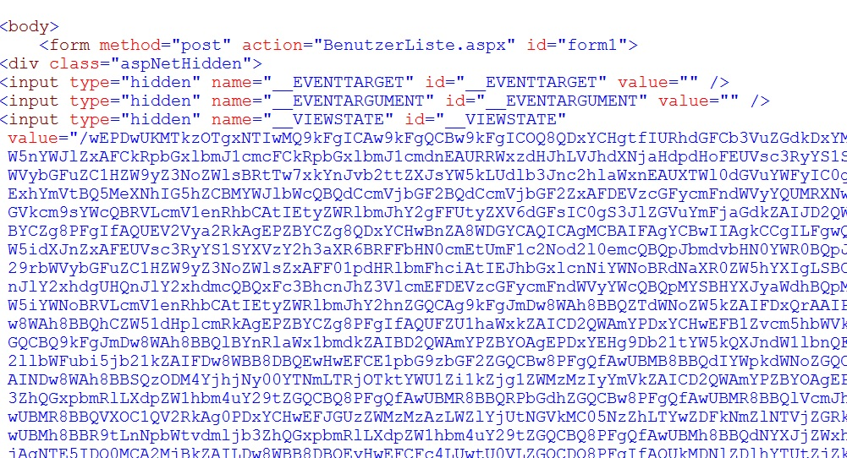
Notes:
I started off using webforms
Image from: http://stackoverflow.com/questions/12086120/how-i-can-deactivate-viewstate-without-control-problems

Slide 6

Notes:
Then I learned about Ruby on Rails, which is great, but where the hell are my semicolons and curly braces?
Ruby is way too much like visual basic…

Slide 7
I <3 {} and ;
Notes:
Ruby is great, but I’m a C# kinda guy
Also, .NET is really fast
Ruby evolves too quickly
Hard to keep up with both

Slide 8
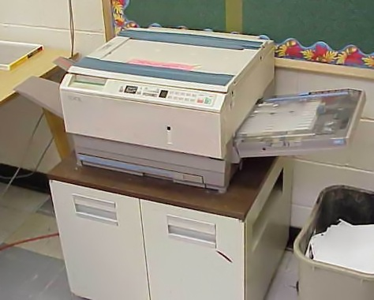
Notes:
Fortunately, Microsoft, along with everyone else, copied Rails.
ASP.NET MVC was born

Slide 9

MVC Documentation
Notes:
Documentation is a little sparse

Slide 10

Notes:
Eventually, I got to the promised land
Today: I’m going to help you get there too.

Slide 11

Road Map
What is our goal?
Why?
MVC Review
New features in ASP.NET MVC 6
Code!

Slide 12
What is the our goal?
Model Driven Development
> Separate business logic (validation) from views and controllers.
Notes:
What does this mean?
We use attributes to define what our data is, and then the view turns that into the representation that we want. Without having to drop a ton of page specific validation code.
Instead of having views that are polluted with lots of field specific JavaScript and client side validation, we move that into unobtrusive attributes, templates, and helpers.

Slide 13
Why?
Achieve separations of concerns.
Keep our code DRY.
Faster app development
Higher Quality Code
Notes:
Other architect-y things
Because you don’t want to wear out ctrl – c and ctrl – v ...
Changing the code in 100 places to implement a new date picker really sucks.
Anyone else have any lousy experiences with this?

Slide 14

Really though: laziness…
By Isderion (Own work) [CC BY-SA 3.0 de (http://creativecommons.org/licenses/by-sa/3.0/de/deed.en)], via Wikimedia Commons
Notes:
http://commons.wikimedia.org/wiki/File:Bear_in_Hammock.JPG
Reference:
“We will encourage you to develop the three great virtues of a programmer:
laziness, impatience, and hubris.”
Larry Wall (He invented Perl)

Slide 15
ASP.NET MVC Review
Model, View, Controller, etc…
Notes:
Gauge the audience’s experience with ASP.NET MVC
See what people are doing with it.
Who’s new to MVC?
Who’s comfortable with MVC?
I’ll be quizzing you.

Slide 16
ASP.NET 5 / ASP.NET MVC 6
Microsoft is bad at versioning
Entity Framework is at version 7
Packaged with Visual Studio 2015 (currently in CTP)
Conceptually similar, but there’s lot of changes.

Slide 17

Use at your own risk!
Notes:
ASP.NET MVC 6 / ASP.NET 5 is still in Beta and not yet complete.
Don’t use it for production projects.
There are lots of changes, many of which are breaking changes.
I got burned making this demo…

Slide 18
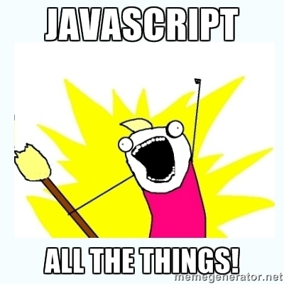
ASP.NET 5 / ASP.NET MVC 6 Changes
json based configuration files
XML is so 2003…
Client side Package Management
Bower
NuGet for server packages
Client side task runners
Grunt or Gulp
Client side scaffolding
Yeoman

Slide 19
ASP.NET 5 / ASP.NET MVC 6 Changes
New ways to build forms
Tag Helpers
View Components
Dependency Injection into Razor Pages

Slide 20
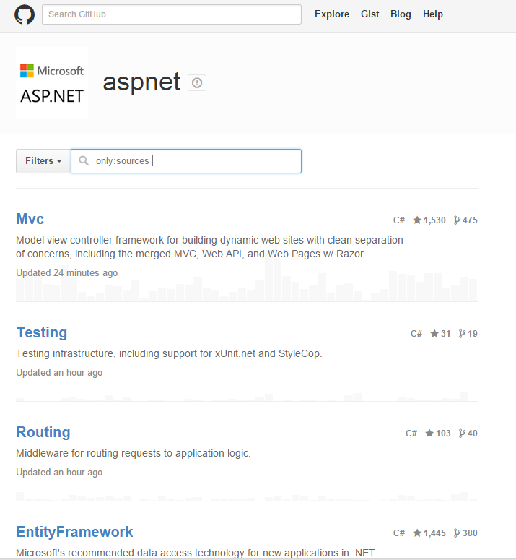
ASP.NET 5 / ASP.NET MVC 6 Changes [Almost] Everything is on GitHub!
Home – Starting Point
github.com/aspnet/Home
MVC – hosts MVC code
github.com/aspnet/Mvc
Entity Framework
github.com/aspnet/EntityFramework

Slide 21
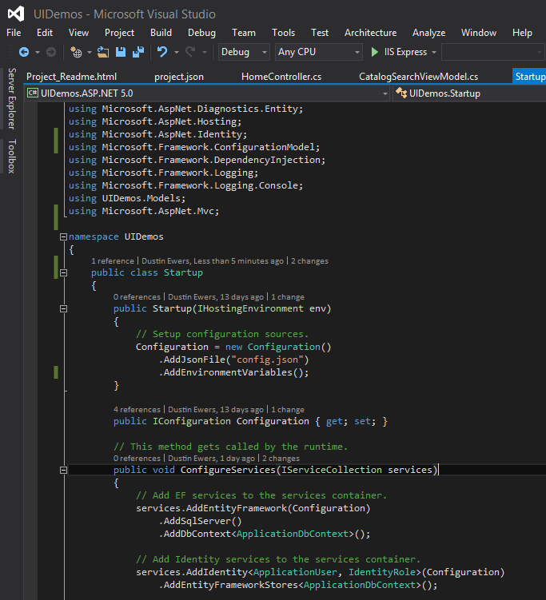
Let’s see some code!

